Slide 1
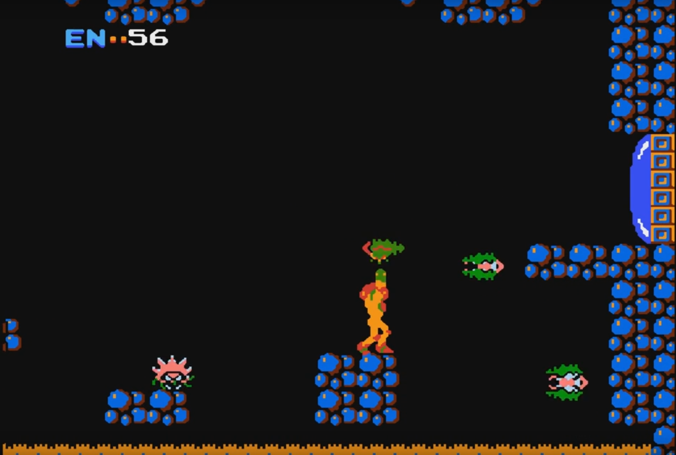
SAMANTHA SPACE
METROID

Slide 2
